Slide 1
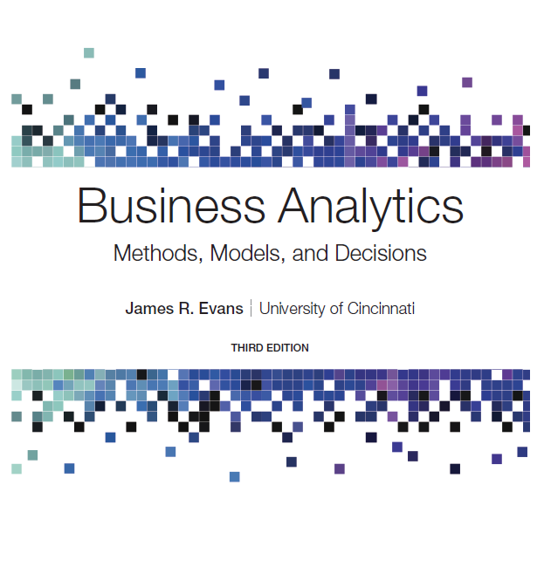
Business Analytics: Methods, Models, and Decisions
Third Edition
Chapter 9
Forecasting Techniques
Slides in this presentation contain hyperlinks. JAWS users should be able to get a list of links by using INSERT+F7
Copyright © 2020, 2016, 2013 Pearson Education, Inc. All Rights Reserved
Notes:
If this PowerPoint presentation contains mathematical equations, you may need to check that your computer has the following installed:
1) MathType Plugin
2) Math Player (free versions available)
3) NVDA Reader (free versions available)

Slide 2
Forecasting Techniques
Managers require good forecasts of future events.
Business Analysts may choose from a wide range of forecasting techniques to support decision making.
Three major categories of forecasting approaches:
Qualitative and judgmental techniques
Statistical time-series models
Explanatory/causal models

Slide 3
Qualitative and Judgmental Forecasting
Qualitative and Judgmental techniques rely on experience and intuition.
They are necessary when historical data is not available or when predictions are needed far into the future.
The historical analogy approach obtains a forecast through comparative analysis with prior situations.
The Delphi method questions an anonymous panel of experts 2-3 times in order to reach a convergence of opinion on the forecasted variable.

Slide 4
Example 9.1: Predicting the Price of Oil
Early 1988 - oil price was about $22 a barrel
Mid-1988 - oil price dropped to $11 a barrel because of oversupply, high production in non-O P E C regions, and lower than normal demand
In the past, O P E C would raise the price of oil.
Historical analogy would forecast a higher price.
However, the price continued to drop even though O P P E C agreed to cut production.
Historical analogies cannot always account for current realities!

Slide 5
Indicators and Indexes
Indicators are measures that are believed to influence the behavior of a variable we wish to forecast.
Indicators are often combined quantitatively into an index, a single measure that weights multiple indicators, thus providing a measure of overall expectation.
Example: Dow Jones Industrial Average (D J I A)

Slide 6
Example 9.2: Economic Indicators
G D P (Gross Domestic Product) measures the value of all goods and services produced.
G D P rises and falls in a cyclic fashion.
Forecasting G D P is often done using leading indicators (series that change before the G D P changes) and lagging indicators (series that follow changes in the G D P) indicators.
Examples
formation of business enterprises
percent change in money supply (M1)
Leading
Lagging
business investment expenditures
prime rate
inventories on hand

Slide 7
Example 9.3: Leading Economic Indicators
An Index of Leading Indicators was developed by the Department of Commerce.
This index is related to the economic performance is available from www.conference-board.org.
It includes measures such as:
average weekly manufacturing hours
new orders for consumer goods
building permits for private housing
S&P 500 stock prices

Slide 8
Statistical Forecasting Models
Time Series - a stream of historical data, such as weekly sales
T = number of periods,
Time series generally have components such as:
random behavior
trends (upward or downward)
seasonal effects
cyclical effects
Stationary time series have only random behavior.
A trend is a gradual upward or downward movement of a time series.

Slide 9
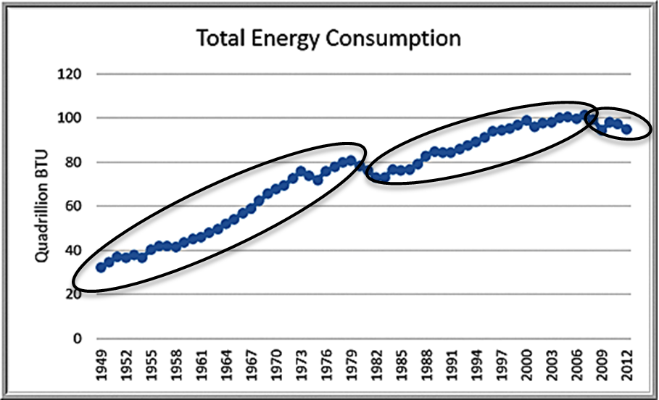
Example 9.4: Identifying Trends in a Time Series
Total Energy Production & Consumption
General upward trend with some short downward trends; the time series is composed of several different short trends.

Slide 10
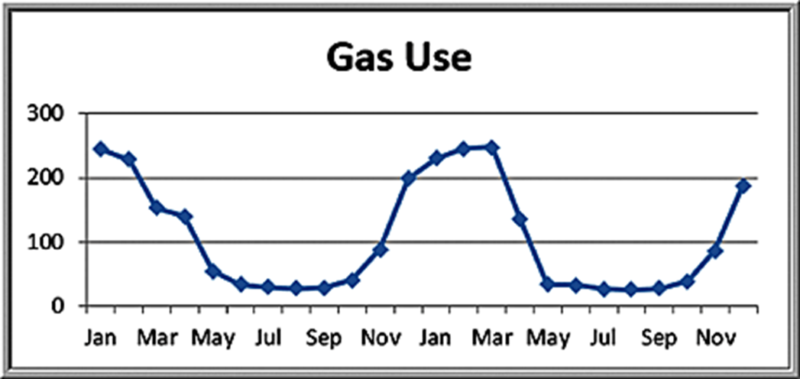
Seasonal Effects
A seasonal effect is one that repeats at fixed intervals of time, typically a year, month, week, or day.

Slide 11
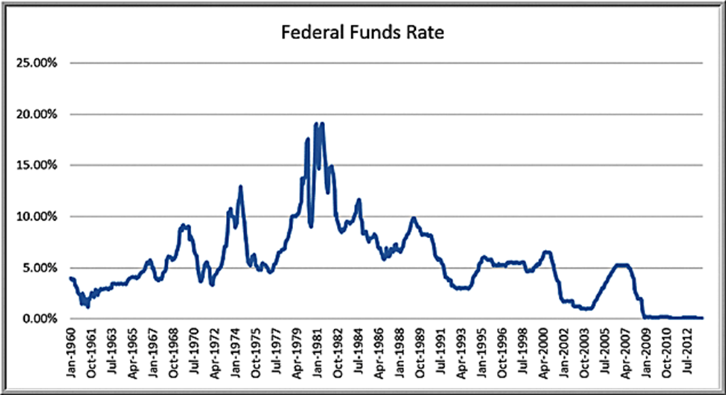
Cyclical Effects
Cyclical effects describe ups and downs over a much longer time frame, such as several years.

Slide 12
Forecasting Models for Stationary Time Series
Moving average model
Exponential smoothing model
These are useful over short time periods when trend, seasonal, or cyclical effects are not significant.

Slide 13
Moving Average Models
The simple moving average method is a smoothing method based on the idea of averaging random fluctuations in the time series to identify the underlying direction in which the time series is changing.
The simple moving average forecast for the next period is computed as the average of the most recent k observations.
Larger values of k result in smoother forecast models since extreme values have less impact.

Slide 14
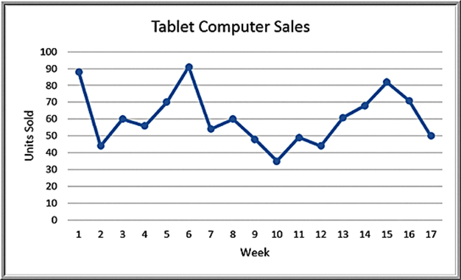
Example 9.5: Moving Average Forecasting
The Tablet Computer Sales file contains the number of units sold over the past 17 weeks.
Three-period moving average forecast for week 18:

Slide 15
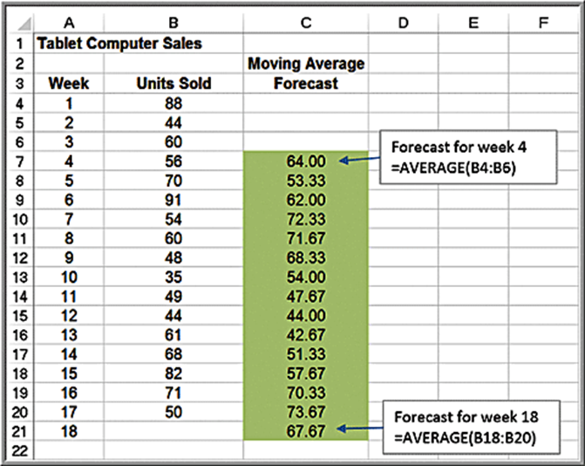
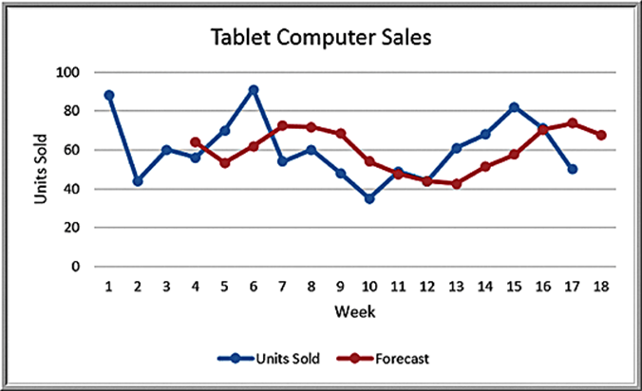
Spreadsheet Implementation of Moving Average Forecasting

Slide 16
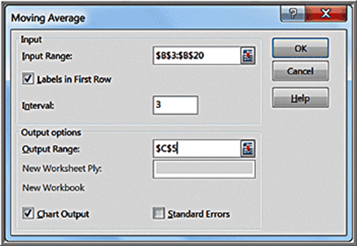
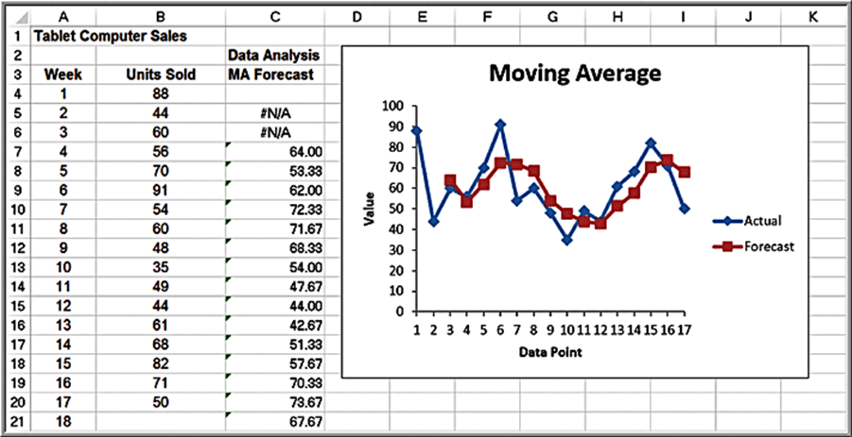
Example 9.6: Using Excel’s Moving Average Tool
Data Analysis options
We do not recommend using the chart or error options because the forecasts generated by this tool are not properly aligned with the data.

Slide 17
Error Metrics and Forecast Accuarcy
Mean absolute deviation (M A D)
Mean square error (M S E)
Root mean square error (R M S E)
Mean absolute percentage error (M A P E)

Slide 18
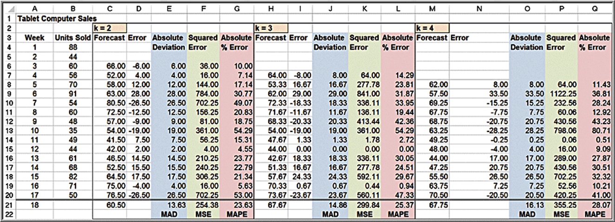
Example 9.7: Using Error Metrics to Compare Moving Average Forecasts
Tablet Computer Sales data
2-, 3-, and 4-period moving average models
2-period model has lowest error metric values.

Slide 19
Exponential Smoothing Models
Simple exponential smoothing model:
where
is the forecast for time period
is the
forecast for period t,
is the observed value in period t,
and α is a constant between 0 and 1 called the smoothing constant.
To begin, set
equal to the actual observation in
period 1,

Slide 20
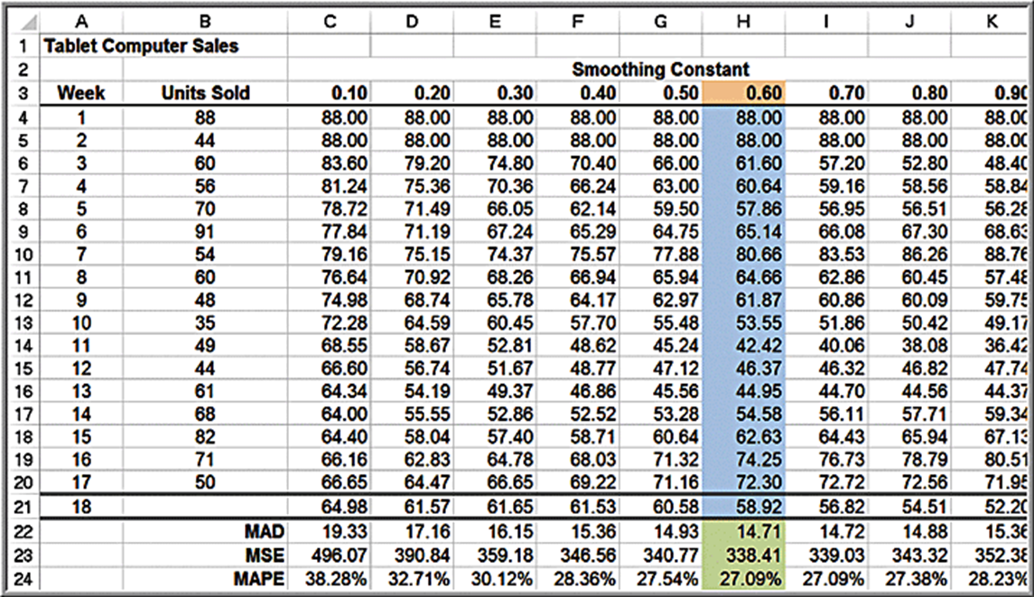
Example 9.8: Using Exponential Smoothing to Forecast Tablet Computer Sales
Forecast for week 3 when

Slide 21

Example 9.9: Finding the Best Exponential Smoothing Model for Tablet Computer Sales
The forecast using α =0.6 provides the lowest error metrics.

Slide 22
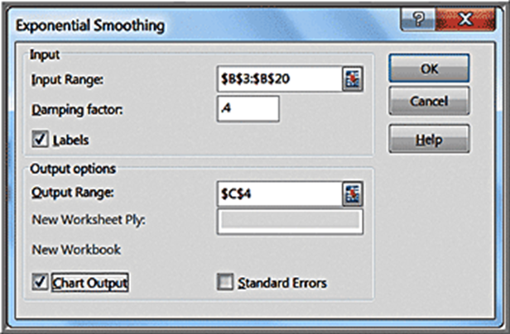
Example 9.10: Using Excel’s Exponential Smoothing Tool (1 of 2)
Select Data Analysis from the Analysis group and then choose Exponential Smoothing.
Note that Damping factor = 1−α
The first cell of the Output Range should be adjacent to the first data point.

Slide 23
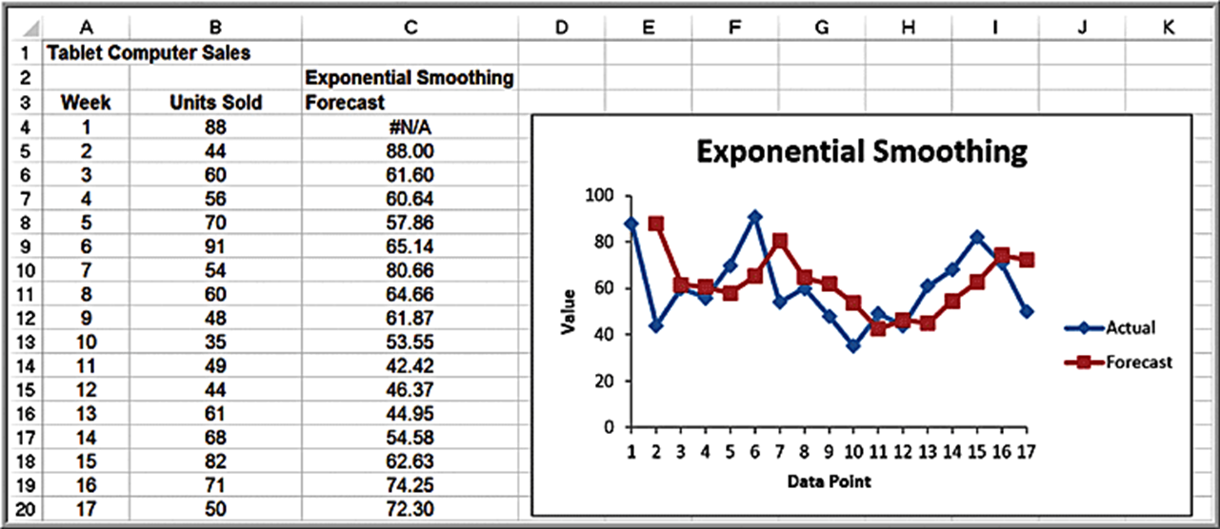
Example 9.10: Using Excel’s Exponential Smoothing Tool (2 of 2)
Exponential Smoothing tool results

Slide 24
Forecasting Models for Time Series with a Linear Trend
Double moving average and double exponential smoothing
Based on the linear trend equation
The forecast for k periods into the future is a function of
the level
and the trend
The models differ in their computations of

Slide 25
Double Exponential Smoothing
Estimates of the parameters are obtained from the following equations:
Initial values are chosen for
Equation (9.8) must then be used to compute
for the entire time series to be able to generate forecasts into the future. The forecast for k periods beyond the last period (period T) is

Slide 26
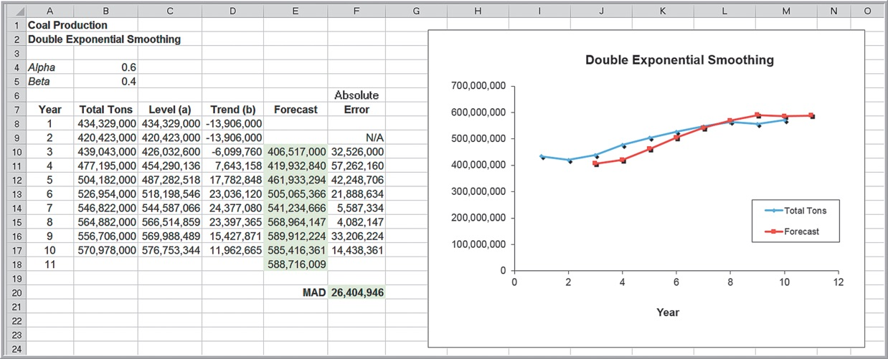
Example 9.11: Double Exponential Smoothing
First ten years of data in the Excel file Coal Production
Choose α = 0.6 and β = 0.4
See text for computational details.

Slide 27
Regression-Based Forecasting for Time Series with a Linear Trend
Simple linear regression can be applied to forecasting using time as the independent variable.

Slide 28
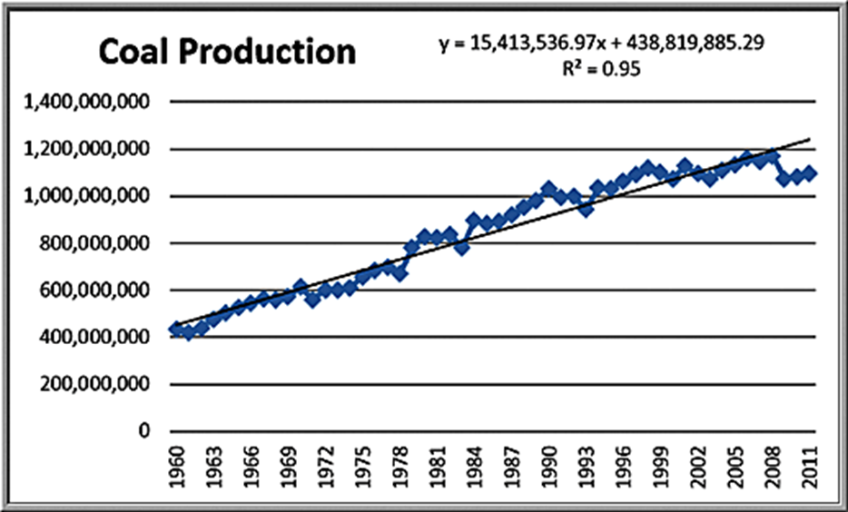
Example 9.12: Forecasting Using Trendlines
Coal Production data with a linear trendline
Note that the linear model does not adequately predict the recent drop in production after 2008.

Slide 29
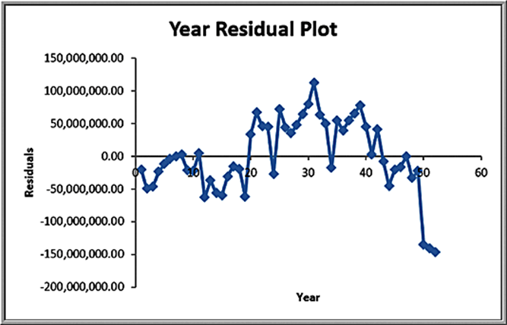
Autocorrelation in Time Series
When autocorrelation is present, successive observations are correlated with one another; for example, large observations tend to follow other large observations, and small observations also tend to follow one another.
In such cases, other approaches, called autoregressive models, are more appropriate.

Slide 30
Forecasting Time Series with Seasonality
When time series exhibit seasonality, different techniques provide better forecasts than the ones we have described:
Multiple regression models with categorical variables for the seasonal components
Holt-Winters models, similar to exponential smoothing models in that smoothing constants are used to smooth out variations in the level and seasonal patterns over time.

Slide 31

Example 9.13: Regression-Based Forecasting for Natural Gas Usage (1 of 3)
Gas & Electric Excel file
Use a seasonal categorical variable with k = 12 levels.
Construct the regression model using k − 1 dummy variables, with January being the reference month.

Slide 32
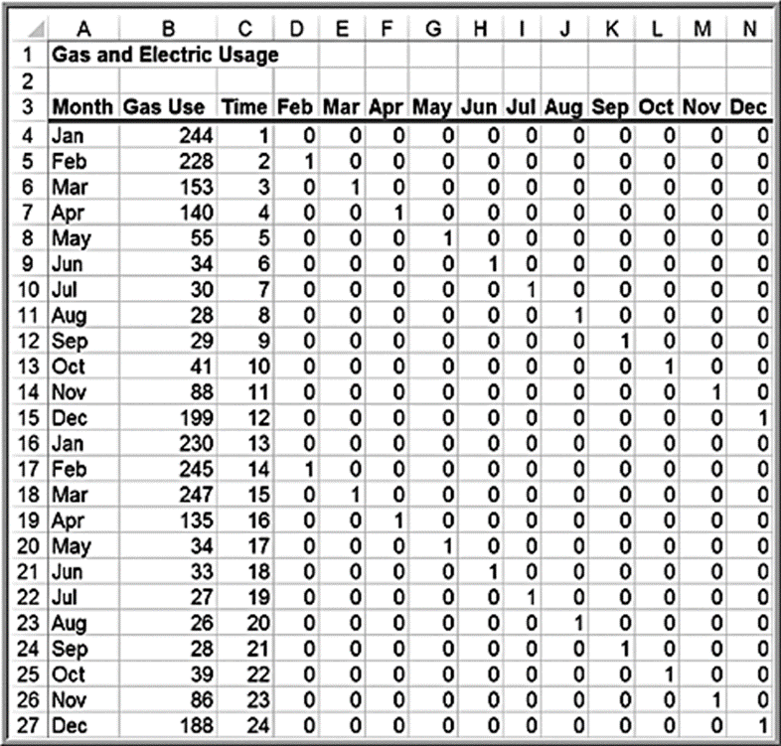
Example 9.13: Regression-Based Forecasting for Natural Gas Usage (2 of 3)
Data matrix

Slide 33
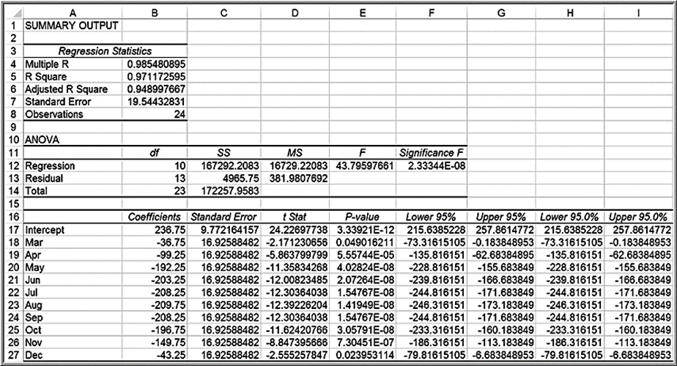
Example 9.13: Regression-Based Forecasting for Natural Gas Usage (3 of 3)
Final regression results (time and February were insignificant)

Slide 34
Holt-Winters Models for Forecasting Time Series with Seasonality and No Trend
The Holt-Winters additive seasonality model with no trend applies to time series with relatively stable seasonality and is based on the equation
The Holt-Winters multiplicative seasonality model with no trend applies to time series whose amplitude increases or decreases over time and is
A chart of the time series should be viewed first to identify the appropriate type of model to use.

Slide 35
Holt-Winters Additive Seasonality Model with No Trend (1 of 2)
The level and seasonal factors are estimated as
The forecast for the next period is

Slide 36
Holt-Winters Additive Seasonality Model with No Trend (2 of 2)
Estimate the level and seasonal factors for the first s periods (that is, the length of a season)
Then we use the smoothing equations to update
and calculate forecasts.

Slide 37
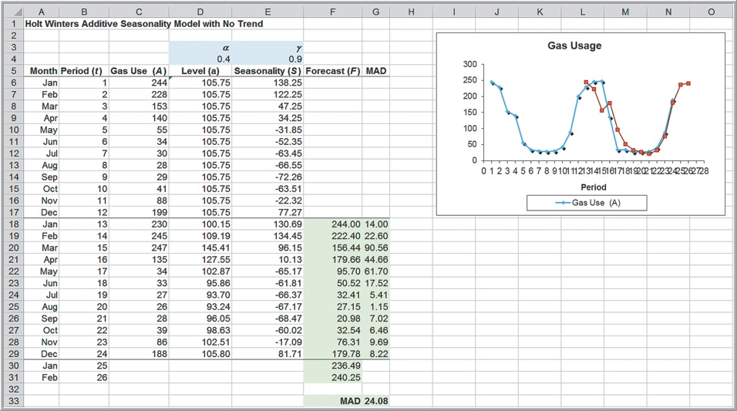
Example 9.14: Using the Holt-Winters Additive Seasonality Model with No Trend
Data for gas usage in the Excel file Gas & Electric
Arbitrarily select
See the text for computational details.

Slide 38
Holt-Winters Multiplicative Seasonality Model with No Trend (1 of 2)
The multiplicative seasonal model has the same basic smoothing structure as the additive seasonal model with some key differences:
The forecast for the next period is

Slide 39
Holt-Winters Multiplicative Seasonality Model with No Trend (2 of 2)
Initialize the values for the level and seasonal factors:
This model can be implemented on a spreadsheet in a similar fashion as the additive model.

Slide 40
Holt-Winters Models for Forecasting Time Series with Seasonality and Trend
The Holt-Winters additive model applies to time series with relatively stable seasonality and is based on the equation
The Holt-Winters multiplicative model applies to time series whose amplitude increases or decreases over time and is
A chart of the time series should be viewed first to identify the appropriate type of model to use.

Slide 41
Holt-Winters Additive Seasonality Model with Trend (1 of 2)
This model is similar to the additive model that incorporates only seasonality, but with the addition of a trend component:
The forecast for period t + 1 is
The forecast for k periods beyond the last period of observed data (period T) is

Slide 42
Holt-Winters Additive Seasonality Model with Trend (2 of 2)
The initial values for level and seasonal factors are the same as in the additive seasonality model without trend, that is, formulas (9.13) and (9.14).
The initial values for the trend component are

Slide 43
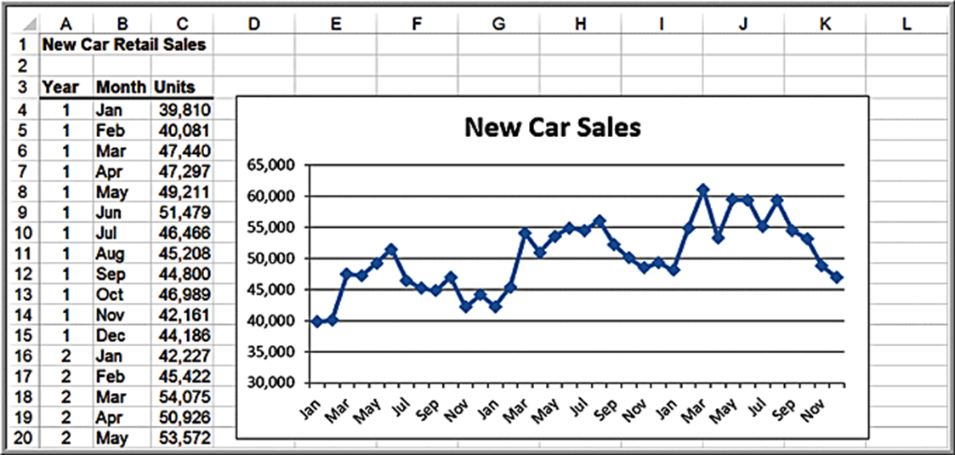
Example 9.15: Using the Holt-Winters Additive Model for Seasonality and Trend (1 of 2)
Excel file New Car Sales
Stable seasonality and an increasing trend

Slide 44
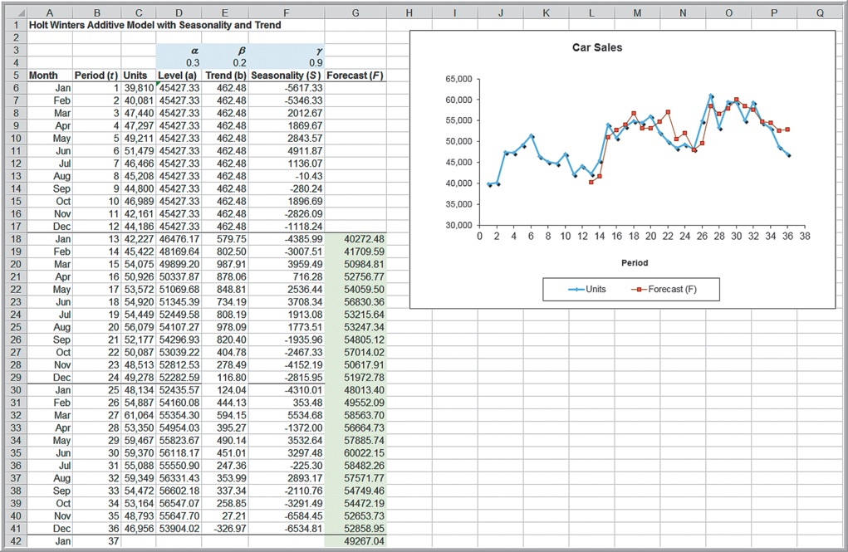
Example 9.15: Using the Holt-Winters Additive Model for Seasonality and Trend (2 of 2)
Arbitrarily select
See text for computational details.

Slide 45
Holt-Winters Multiplicative Seasonality Model with Trend (1 of 2)
The Holt-Winters multiplicative model is similar to the additive model for seasonality, but with a trend component:

Slide 46
Holt-Winters Multiplicative Seasonality Model with Trend (2 of 2)
The forecast for period t + 1 is
The forecast for k periods beyond the last period of observed data (period T) is
Initialization is performed in the same way as for the multiplicative model without trend. The model can be implemented in a similar fashion on a spreadsheet as the additive model.

Slide 47
Selecting Appropriate Time-Series-Based Forecasting Method
Blank | No Seasonality | Seasonality
No trend | Simple moving average or simple exponential smoothing | Holt-Winters additive or multiplicative seasonality models without trend or multiple regression
Trend | Double exponential smoothing | Holt-Winters additive or multiplicative seasonality models trend

Slide 48
Regression Forecasting with Causal Variables
In many forecasting applications, other independent variables besides time, such as economic indexes or demographic factors, may influence the time series.
Explanatory/causal models, often called econometric models, seek to identify factors that explain statistically the patterns observed in the variable being forecast, usually with regression analysis.

Slide 49
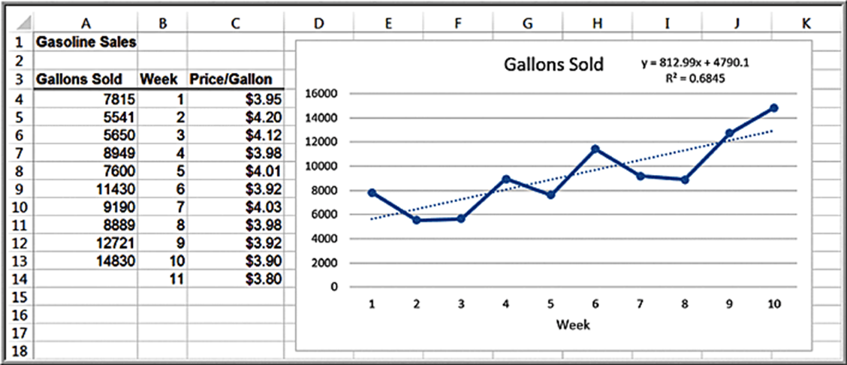
Example 9.16: Forecasting Gasoline Sales Using Simple Linear Regression
Excel file Gasoline Sales
Simple trendline using week as the independent variable
Predicted sales for week 11 =

Slide 50

Example 9.17: Incorporating Causal Variables in a Regression-Based Forecasting Model (1 of 2)
The average price per gallon changes each week, and this may influence consumer sales. Average price per gallon is a causal variable.
Develop a multiple linear regression model to predict gasoline sales using both time and price per gallon.

Slide 51
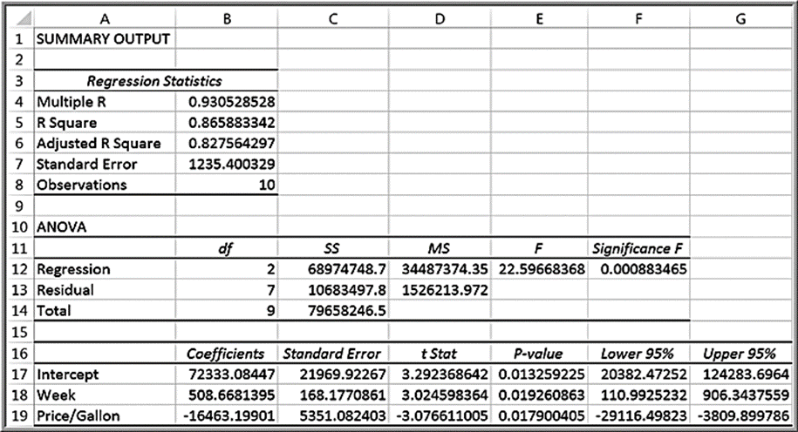
Example 9.17: Incorporating Causal Variables in a Regression-Based Forecasting Model (2 of 2)
Multiple regression model
Predicted sales for week 11

Slide 52
The Practice of Forecasting
Judgmental and qualitative methods are used for forecasting sales of product lines and broad company and industry forecasts.
Simple time-series models are used for short- and medium-range forecasts.
Regression methods are typically used for long-term forecasts.

